Slide 1
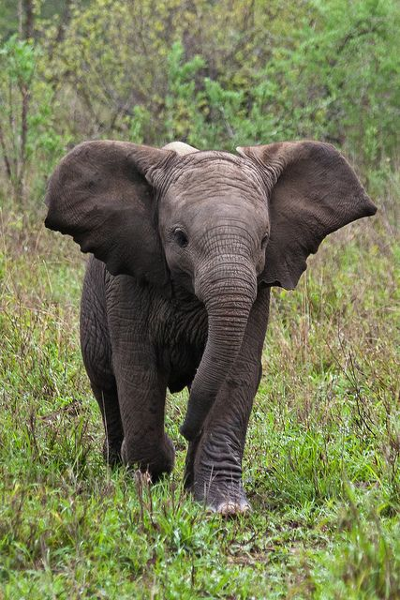
Object Localization
Elephant
Single object in the image
Involves both classification and regression.
Use LabelImg to build training data
Use ImgAug for augmentation

Slide 2
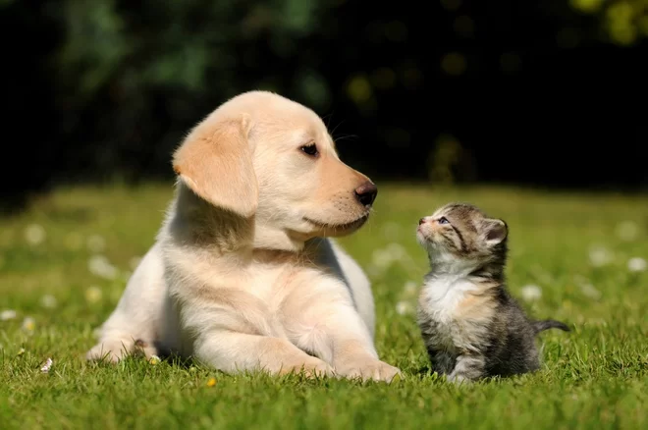
Dog
Cat
Object Detection
Finding locations of multiple objects

Slide 3
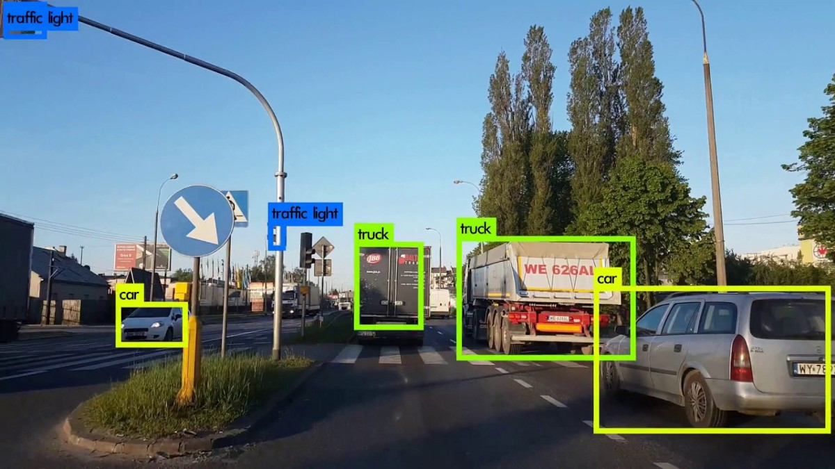
Can involve a very complex scenery

Slide 4

What should the model predict for Object detection?

Slide 5
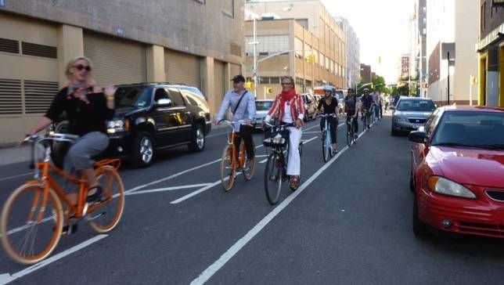
CNN
Elephant: (x, y, w, h)
Each image may need different number of outputs
CNN
Dog: (x, y, w, h)
Cat : (x, y, w, h)
Person 1: (x, y, w, h)
Person 2 : (x, y, w, h)
. . . .
Bike 1: (x, y, w, h)
. . . .
Car 1: (x, y, w, h)
CNN

Slide 6
How do we build an Object Detector?
Object detection = Lots of Object localization

Slide 7
Break down original picture into multiple pictures

Slide 8



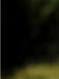
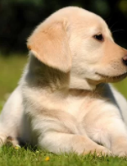


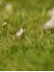
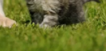
From one original image, we will create lots of images e.g 1000 images

Slide 9
Assume each new image has exactly one object in it

Slide 10
Model
Dog: (x, y, w, h)
Perform Object Localization for each new image

Slide 11
Model
Cat: (x, y, w, h)
Perform Object Localization for each new image

Slide 12
We will use ‘Background’ as additional class in our dataset
Model
Background: (x, y, w, h)
Perform Object Localization for each new image

Slide 13
Model
Background: (x, y, w, h)
Each new image is also called Region of Interest (ROI)

Slide 14
Model
Background: (x, y, w, h)
Majority of new images will have Background class object in them

Slide 15
How many images (RoI) should we create from original image?
It’s a hyper-parameter!

Slide 16
How to create RoIs from an image?
Let’s explore different architectures to answer this question.

Slide 17
Region based CNN
(R-CNN)
Used Selective Search to identify RoIs in an image
Created 2000 RoIs from each picture

Slide 18
What is Selective Search?
A non Deep Learning algorithm
Tries to identify different RoIs that ‘may’ contain objects.
Implementation available in OpenCV

Slide 19
How Selective Search works?
Color similarity
Texture similarity
Size Similarity
Shape compatibility
It tries to identify different regions based on similarity between adjacent areas.

Slide 20
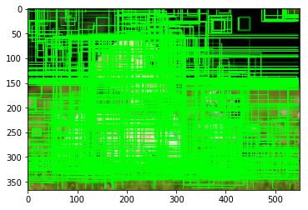
Selective Search usually provides 1000s of RoIs for each image

Slide 21
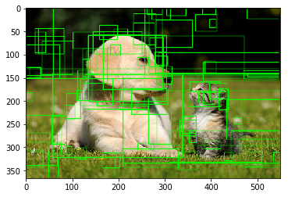
We can limit number of RoI results based on ‘objectiness’ score

Slide 22

Classification
FC Softmax
Dog
Cat
CNN
Background
Apply Selective Search
FC
Take out one region
x, y, w, h
Regression
R-CNN

Slide 23
Classification
FC Softmax
Dog
Cat
CNN
Background
Apply Selective Search
FC
Take out another region
x, y, w, h
Regression
R-CNN

Slide 24
How do we calculate LOSS?
Loss is calculated for each RoI (new image)
We have to prepare actual label for each RoI

Slide 25
How many actual labels we need?
Number of classes (C) + 4 for each RoI
For all the RoIs → 2000 * (C+4)

Slide 26
How do we create so many labels?
Use a tool e.g LabelImg to create annotations for actual objects.
Prepare labels for each RoI using
RoI coordinates (available from Selective Search)
Actual Object Boxes (available from LabelImg)
Use code to prepare RoI labels (and not manually)

Slide 27
RoIs
(From Selective Search)
To prepare label for each RoI
Calculate overlap (IOU) between RoI and actual object boxes
If IOU is above a threshold e.g 0.5
Class Label: Actual class
Regression Label: Actual Box coordinates
If IOU < threshold:
Class Label: Background
Regression Label: Set to [0,0,0,0], it will be ignored during loss calculation
Actual object box
(from LabelImg)
Building Labels for each RoI

Slide 28
RoIs
(From Selective Search)
1. Let’s assume we have 4 actual classes -
- Dog (1), Cat(2), Elephant (3), Horse(4).
- Background class (0)
2. IOU Calculations
- IOU for Yellow RoI and Actual Box (White) = 0.6
- IOU for Blue RoI and Actual Box (White) = 0.1
- IOU Threshold = 0.5 (we have to decide)
3. Label for Yellow RoI ( IOU - 0.6 above threshold)
- Class (Elephant): [0, 0, 0, 1, 0]
- Regression Labels: [x,y,w,h] of White actual box
4. Label for Blue RoI ( IOU - 0.1 below threshold)
- Class (Background): [1, 0, 0,0, 0]
- Regression Labels: [0,0,0,0]
Actual object box
(from LabelImg)
Building Labels for each RoI

Slide 29
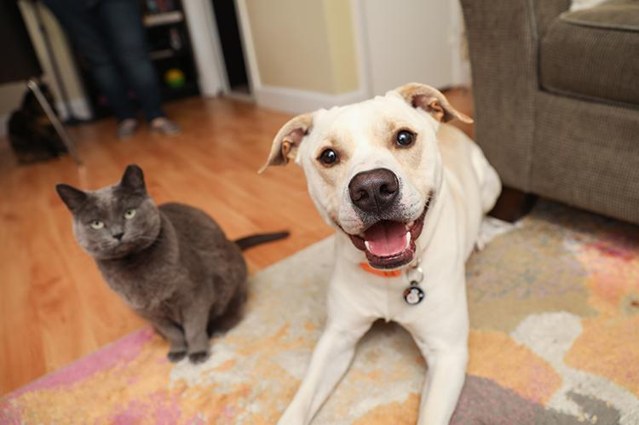
ROI
(Selective Search)
1. IOU Calculations
- IOU for Yellow RoI and Actual box of Dog : 0.05
- IOU for Yellow RoI and Actual box of Cat : 0.07
2. Labels for Yellow RoI
Classification (Background): [1, 0, 0, 0, 0]
Regression: [0, 0, 0, 0]
Actual Object boxes
(from labelImg)
Let’s consider an image with two objects

Slide 30
ROI
(Selective Search)
x,y
w
1. IOU Calculations
- IOU for Green RoI and Actual box of Dog : 0.08
- IOU for Green RoI and Actual box of Cat : 0.62
2. Labels for Green RoI
Classification (Cat): [0, 0, 1, 0, 0]
Regression: [x, y, w, h] - actual cat box coordinates
h
Actual Object boxes
(from labelImg)
Let’s consider an image with two objects

Slide 31
ROI
(Selective Search)
x,y
w
1. An RoI will have only one object
2. If IOU with multiple actual boxes is above threshold, then highest IOU object will be considered.
h
Actual Object boxes
(from labelImg)
Let’s consider an image with two objects

Slide 32
2000 Regions of Interest (ROI)
Extracted regions are resized
Classification
FC Softmax
Dog
Images
Selective Search
(Non-DL)
Cat
CNN
FC
x, y, w, h
Regression
R-CNN

Slide 33
Good Detection Results
Provided a workable approach for Object Detection
Very slow to train and Predict
49 Secs to predict one Image
0.02 fps
Lots of CNN Computations
~2000/image
R-CNN

Slide 34
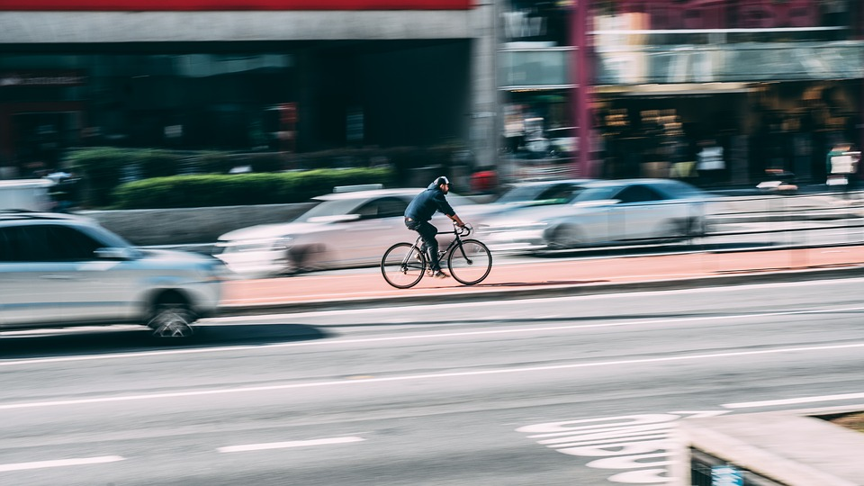
Fast R-CNN
Simplifying RCNN

Slide 35
RoIs
Classification
CNN runs 2000 times for each image
FC Softmax
Dog
Images
Selective Search
(Non-DL)
Cat
CNN
FC
x, y, w, h
Regression
R-CNN

Slide 36
RoIs
Classification
CNN runs 2000 times for each image
FC Softmax
Dog
Images
Selective Search
(Non-DL)
Cat
CNN
Feature Map for each RoI
FC
What is the output of CNN?
x, y, w, h
Regression
R-CNN

Slide 37
How does Fast R-CNN speeds up R-CNN?
It does not break original image in 2000 RoIs directly.
Rather it breaks original image feature map into 2000 RoI feature maps.

Slide 38
Regions of Interest (ROI)
Selective Search
(Non-DL)
Classification
ROI
Pooling
Layer
FC Softmax
Dog
Images
Cat
CNN
FC
x, y, w, h
FAST R-CNN
Image is passed through CNN only once, rather RoI Feature maps are created from Image feature map
Regression

Slide 39
Regions of Interest (ROI)
Selective Search
(Non-DL)
Classification
ROI
Pooling
Layer
FC Softmax
Dog
Images
Cat
CNN
FC
x, y, w, h
RoI Pooling Layer
Resizes feature maps to be of equal shape using Max pooling & Average pooling
Regression

Slide 40
What is RoI Pooling Layer?

Slide 41
CNN
Feature Map
7 x 7 x 2048
224
CNN usually will produce a feature map which spatially is much smaller than original image. In the figure above, we started with a 224x224 image and got a feature map of 7x7 i.e. a reduction by a factor of 32 (224/7 = 32).
224

Slide 42
RoIs
(Selective Search)
RoI coordinates from Selective Search will be in original image scale e.g 224x224
60
30, 160
170, 160
60
CNN
Feature Map
7 x 7 x 2048
50
224
150
100
30, 10
170, 10
224

Slide 43
RoIs
(Selective Search)
Original image Feature Map
60
0.06 | 0.05 | 0.1 | 0.03 | 0.04 | 0.0 | 0.01
0.1 | 0.9 | 0.3 | 0.07 | 0.01 | 0.0 | 0.0
0.3 | 0.01 | 0.4 | 0.2 | 0.05 | 0.05 | 0.1
0.2 | 0.9 | 0.6 | 0.3 | 0.7 | 0.6 | 0.2
0.66 | 0.7 | 0.3 | 0.1 | 0.12 | 0.36 | 0.03
0.01 | 0.5 | 0.45 | 0.05 | 0.6 | 0.5 | 0.06
0.0 | 0.1 | 0.7 | 0.1 | 0.3 | 0.92 | 0.05
30, 160
170, 160
60
CNN
50
224
150
100
30, 10
170, 10
Feature map of whole image - 7x7x2048
224
How do we get RoI feature maps?

Slide 44
Building RoI Feature Map
30, 160
170, 160
RoI Coordinates | Divide coords by 32 | Convert to Int (Floor)
30,160 | 0.9, 5 | 0, 5
170, 160 | 5.3, 5 | 5, 5
30,10 | 0.9, 0.3 | 0, 0
170,10 | 5.3, 0.3 | 5, 0
224
150
30, 10
170, 10
Convert RoI coordinates from original image scale (224x224) to Feature map scale (7x7)
224
Let’s take one RoI to understand the steps

Slide 45
Building RoI Feature Map
0.06 | 0.05 | 0.1 | 0.03 | 0.04 | 0.0 | 0.01
0.1 | 0.9 | 0.3 | 0.07 | 0.01 | 0.0 | 0.0
0.3 | 0.01 | 0.4 | 0.2 | 0.05 | 0.05 | 0.1
0.2 | 0.9 | 0.6 | 0.3 | 0.7 | 0.6 | 0.2
0.66 | 0.7 | 0.3 | 0.1 | 0.12 | 0.36 | 0.03
0.01 | 0.5 | 0.45 | 0.05 | 0.6 | 0.5 | 0.06
0.0 | 0.1 | 0.7 | 0.1 | 0.3 | 0.92 | 0.05
RoI Coordinates (224x224 scale) | ROI Coordinates (7x7 Scale)
30.160 | 0, 5
170, 160 | 5, 5
30,10 | 0, 0
170,10 | 5, 0
0.3 | 0.01 | 0.4 | 0.2 | 0.05
0.2 | 0.9 | 0.6 | 0.3 | 0.7
0.66 | 0.7 | 0.3 | 0.1 | 0.12
0.01 | 0.5 | 0.45 | 0.05 | 0.6
0.0 | 0.1 | 0.7 | 0.1 | 0.3
ROI Feature Map (5x5x2048)
Original image Feature Map - 7x7x2048

Slide 46
Feature map for another RoI
RoI Coordinates | Divide coords by 32 | Convert to Int (Floor)
170,10 | 5.3, 0.3 | 5, 0
220, 10 | 6.9, 0.3 | 6, 0
220,110 | 6.9, 3.4 | 6, 3
170,110 | 5.3, 3.4 | 5, 3
170, 110
220, 110
224
170, 10
220, 10
224
Convert RoI coordinates from original image scale (224x224) to Feature map scale (7x7)

Slide 47
Feature map for another ROI area
0.06 | 0.05 | 0.1 | 0.03 | 0.04 | 0.0 | 0.01
0.1 | 0.9 | 0.3 | 0.07 | 0.01 | 0.0 | 0.0
0.3 | 0.01 | 0.4 | 0.2 | 0.05 | 0.05 | 0.1
0.2 | 0.9 | 0.6 | 0.3 | 0.7 | 0.6 | 0.2
0.66 | 0.7 | 0.3 | 0.1 | 0.12 | 0.36 | 0.03
0.01 | 0.5 | 0.45 | 0.05 | 0.6 | 0.5 | 0.06
0.0 | 0.1 | 0.7 | 0.1 | 0.3 | 0.92 | 0.05
RoI Coordinates (224x224 scale) | ROI Coordinates (7x7 scale)
170,10 | 5, 0
220, 10 | 6, 0
220,110 | 6, 3
170,110 | 5, 3
0.36
0.5
0.92
ROI Feature Map
3x1x2048
Original image Feature Map
7x7x2048

Slide 48
Different Feature maps will have different sizes
0.3 | 0.01 | 0.4 | 0.2 | 0.05
0.2 | 0.9 | 0.6 | 0.3 | 0.7
0.66 | 0.7 | 0.3 | 0.1 | 0.12
0.01 | 0.5 | 0.45 | 0.05 | 0.6
0.0 | 0.1 | 0.7 | 0.1 | 0.3
0.36
0.5
0.92
ROI Feature Map for another area
ROI Feature Map for One area
Next Layer will expect all ROI feature Maps to be of same size

Slide 49
How do we make all RoI Feature Maps to be same size?
We can use Max Pool or Avg Pool

Slide 50
Resizing ROI Feature Maps
0.3 | 0.01 | 0.4 | 0.2 | 0.05
0.2 | 0.9 | 0.6 | 0.3 | 0.7
0.66 | 0.7 | 0.3 | 0.1 | 0.12
0.01 | 0.5 | 0.45 | 0.05 | 0.6
0.0 | 0.1 | 0.7 | 0.1 | 0.3
0.36
0.5
0.92
ROI Feature Map for another area
ROI Feature Map for One area
Let’s say we want to resize all RoI feature Maps to 2x2.
Also let’s say we want to use a 3x3 pool size with stride 3.

Slide 51
Resizing ROI Feature Maps
0.3 | 0.01 | 0.4 | 0.2 | 0.05
0.2 | 0.9 | 0.6 | 0.3 | 0.7
0.66 | 0.7 | 0.3 | 0.1 | 0.12
0.01 | 0.5 | 0.45 | 0.05 | 0.6
0.0 | 0.1 | 0.7 | 0.1 | 0.3
0.9 | 0.7
0.5 | 0.6
2x2 ROI Feature Map for 1st area
ROI Feature Map for 1st area
In RoI Pooling, you can have uneven size parts

Slide 52
Resizing ROI Feature Maps
0.36
0.5
0.92
0.92 | 0.0
0.0 | 0.0
2x2 ROI Feature Map for 2nd area
ROI Feature Map for 2nd area
In RoI Pooling, you can have uneven size parts

Slide 53
FAST R-CNN
Reduced CNN Computations
2.3 Secs to predict on One Image
0.5 fps
Still uses Selective Search
It’s much faster …. but slow for real time detection (require >20 fps)

Slide 54
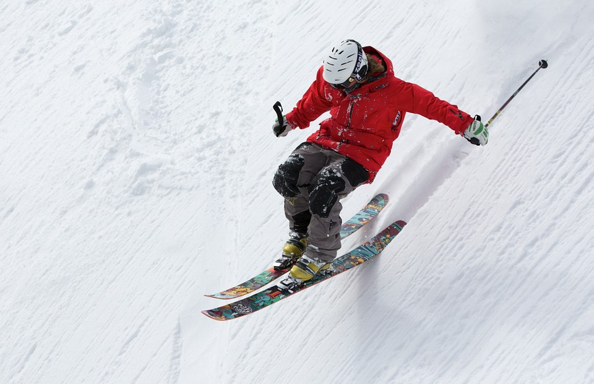
Faster RCNN
Bringing RoI in the network

Slide 55
Regions of Interest (ROIs)
Selective Search
(Non-DL)
Classification
ROI
Pooling
Layer
FC Softmax
Dog
Images
Cat
CNN
FC
x, y, w, h
Fast R-CNN
Regression

Slide 56
Regions of Interest (ROI)
Selective Search
(Non-DL)
Classification
ROI
Pooling
Layer
FC Softmax
Dog
Images
Cat
CNN
FC
x, y, w, h
Faster R-CNN
Regression

Slide 57
How do we get RoIs then?
We use a Neural Network!

Slide 58
Region Proposal network (RPN)
CNN
Images
ROI
Pooling
Layer
FC Softmax
Dog
Cat
Faster R-CNN
RoI identification is done by a neural network called Region Proposal Network (RPN)
FC
x, y, w, h

Slide 59
How does Regional Proposal Network (RPN) work?

Slide 60
RoI Coordinates
[20, 7, 92, 120]
[17, 32, 66, 54]
.
.
.
[35, 43, 78, 99]
Arranged by confidence score of objectiness
Selective Search
Non ML Algorithm
Selective Search provides RoI Coordinates for 2000 RoIs

Slide 61
RoI Coordinates
[20, 7, 92, 120]
[17, 32, 66, 54]
.
.
.
[35, 43, 78, 99]
Objectiness Score
0.72
0.84
.
.
.
0.05
Region Proposal Network
RPN also provides very similar output as Selective Search

Slide 62
RoI Coordinates
[20, 7, 92, 120]
[17, 32, 66, 54]
.
.
.
[35, 43, 78, 99]
Objectiness Score
0.72
0.84
.
.
.
0.05
Region Proposal Network
CNN
(e.g ResNet)
But RPN uses Image Feature map as input (and not original image)

Slide 63
How many RoIs it will find?
We fix number of RoIs!

Slide 64
How does RPN finds interesting areas (Selective Search used Color/Texture/Shape etc.)
We help RPN by giving it areas to look in using Anchor Boxes.

Slide 65
Anchor Boxes are predetermined areas of image which RPN is asked to look at for objectiness. Usually there are several thousand Anchor boxes.
Anchor Boxes
(Defined by us)
Image
Feature NW
(CNN e.g VGG)
Region Proposal Network
(CNN)
RoIs (x,y,w,h)
Non-Maximum
Suppression
(Filter overlapping RoIs)
RoIs with Score
Filter Top-K RoIs
e.g K =500
Top RoIs sent to RoI Pooling Layer
Feature Map
38 x 51 x 512
Object Score
600 x 800 x 3
Reducing number of RoIs for faster training
RPN in Faster R-CNN
(Provides RoIs with higher object score)

Slide 66
How do we come up with the image areas i.e anchor boxes for RPN to look into?

Slide 67
0
100
Identify anchor points for input image. In this example, our image is 600 x 800 x 3
200
Usually number of anchor points are same as feature map e.g if feature map is 38x51x d then number of anchor points will be 38 x 51
300
400
Place boxes of different size and aspect ratio at each anchor point.
500
600
100
200
300
400
500
600
700
800
Understanding Anchor Boxes

Slide 68
0
1. Place a box of a defined size e.g 128 x 128 at the anchor point.
100
2. The image part covered by this box becomes an RoI which will be looked up by RPN network for objectiness and more precise boundary for the object as usually object size is not exactly same as anchor box size.
200
300
3. We place other anchor boxes at this point with different aspect ratios e.g 1:2 or 2:1 ratio between width and height.
400
500
4. We also place anchor boxes of different sizes e.g 256 x 256 or 512 x 512 to create more anchor boxes for RPN to look at.
600
100
200
300
400
500
600
700
800
Understanding Anchor Boxes

Slide 69
0
5. Usually we define 10s of thousands of anchor boxes for an image in Faster R-CNN.
100
200
For example:
Number of anchor points : 38 x51
(each feature map point can be an anchor)
300
Number of anchor boxes at each point : 9
(3 sizes and 3 aspect ratios)
400
Total # anchor boxes for an image : 17,442
(38 x 51 x 9)
500
600
Number of anchor boxes remain same for every image in a dataset.
100
200
300
400
500
600
700
800
Understanding Anchor Boxes

Slide 70
How do we calculate loss for Faster R-CNN?

Slide 71
Region Proposal network (RPN)
Object present or NOT
3
Bounding Box Regression Loss
4
CNN
Images
ROI
Pooling
Layer
FC Softmax
Dog
2
Cat
Faster R-CNN has 4 type of losses calculated.
2 each for RPN and Detection Network.
Total loss is sum of all 4 losses.
FC
1
x, y, w, h

Slide 72
Faster R-CNN
Uses Deep Learning for RoI
Most accurate architecture for Object detection
Takes 0.2 secs to predict on One Image
i.e. 5 fps
High accuracy, but still not suitable for real time

Slide 73
How do we build Object detectors which can perform in real time?

Slide 74

Single Shot Detectors
Expediting Detection

Slide 75
R-CNN based models have 3 types of networks
Feature Network
Region Proposer
Detector Network
Higher Computation cost

Slide 76
To run model faster, we need to reduce computations
Feature
Network
Region Proposer
Detector Network
Single Shot Detectors
Can perform real time detections

Slide 77
Popular SSD Architectures
Multibox SSD
SSD
You Only Look Once
YOLO

Slide 78
Multibox SSD
Significantly Faster than Faster R-CNN
5 fps vs 59 fps
Comparable Accuracy
(Pascal VOC 2007)
mAP of 74.3% vs 73.2%

Slide 79
RPN
CNN
(e.g ResNet)
Images
ROI
Pooling
Layer
FC Softmax
Dog
Cat
Faster R-CNN → SSD
In SSD, we do not have RPN or RoI Pooling Layer
FC
x, y, w, h

Slide 80
SSD Detection Layers
Class Probabilities
CNN
(Feature NW)
Images
Bounding Box Coordinates
SSD Architecture
SSD uses only Feature Network and Detection Network

Slide 81
Who will provide RoIs in SSD?
As there is no RPN/Selective Search, we have to provide RoI coordinates

Slide 82
How do we get RoIs in SSD?
SSD uses an approach very similar to anchor boxes in Faster R-CNN

Slide 83
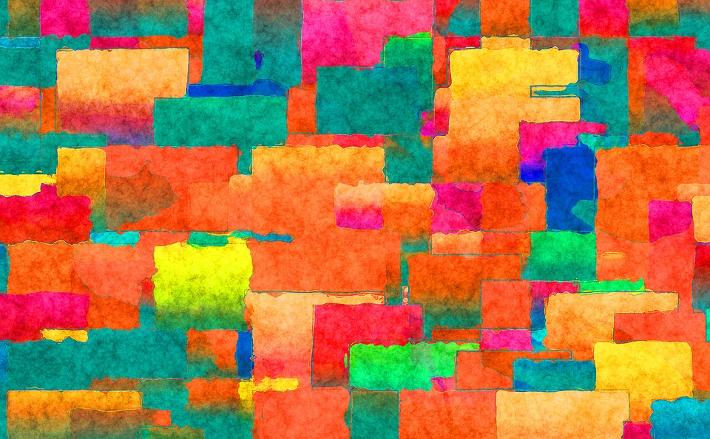
Building RoIs
in SSD

Slide 84
Building RoIs (called Priors) in SSD
Divide the image into multiple parts as a grid of some defined size e.g 4x4
Center point of each grid cell is treated as ‘anchor point’ e.g in this example, we have created 16 anchor points
4x4 Grid

Slide 85
Building RoIs (called Priors) in SSD
Divide the image into multiple parts as a grid of some defined size e.g 4x4
Center point of each grid cell is treated as ‘anchor point’ e.g in this example, we have created 16 anchor points
Each anchor point will have multiple RoIs or Priors based on size and aspect ratio (similar to anchor box in Faster R-CNN)
How many RoIs will we have for all the grid cells?
4x4 Grid

Slide 86
Building RoIs (called Priors) in SSD
Divide the image into multiple parts as a grid of some defined size e.g 4x4
Center point of each grid cell is treated as ‘anchor point’ e.g in this example, we have created 16 anchor points
Each anchor point will have multiple RoIs or Priors based on size and aspect ratio (similar to anchor box in Faster R-CNN)
96
(16 cells x 6 Priors per cell)
4x4 Grid

Slide 87
Will any of the 96 RoIs overlap well with the objects (IOU > threshold)?
No
4x4 Grid

Slide 88
How do build RoIs which will overlap well with bigger size object in image?
We can use another Grid size.
In SSD, we use multiple grids.

Slide 89
Number of Priors (RoIs) can be different for each grid size
2x2 Grid

Slide 90
We can also have 1x1 Grid
To cover really big objects in image
1x1 Grid

Slide 91
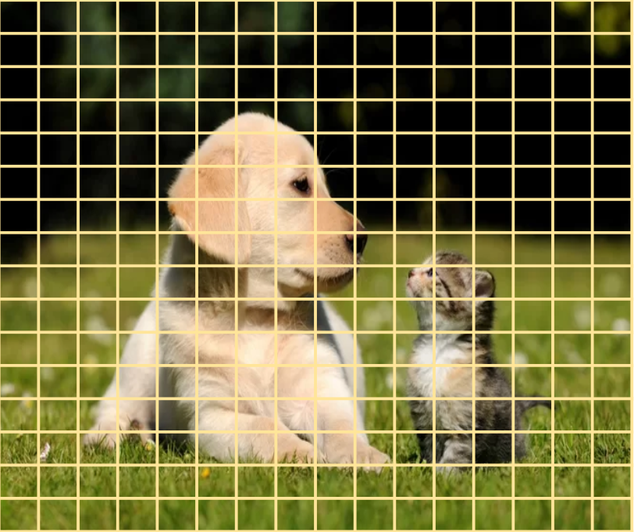
…. or grids with really small grid cells
To detect really small objects in image
16x16 Grid

Slide 92
Number of RoIs in SSD are decided by ..
1. Number of Grids
2. Grid Sizes
3. Number of Priors in each grid cell
All these parameters we have to decide i.e they are hyper-parameters.
16x16 Grid

Slide 93
Grid Size | # Priors per cell
38 x 38 | 4
19 x 19 | 6
10 x 10 | 6
5 x 5 | 6
3 x 3 | 4
1 x 1 | 4
An SSD uses multiple grids to improve model accuracy
Grid size and # priors used in original SSD paper

Slide 94
Grid Size | # Priors per cell | # of RoIs?
38 x 38 | 4
19 x 19 | 6
10 x 10 | 6
5 x 5 | 6
3 x 3 | 4
1 x 1 | 4
How many total RoIs?
Grid size and # priors used in original SSD paper

Slide 95
Grid Size | # Priors per cell | # of RoIs
38 x 38 | 4 | 5,776
19 x 19 | 6 | 2,166
10 x 10 | 6 | 600
5 x 5 | 6 | 150
3 x 3 | 4 | 36
1 x 1 | 4 | 4
Total |  | 8,732
How many total RoIs?
Grid size and # priors used in original SSD paper

Slide 96
Grid Size | # Priors per cell | # of RoIs | # of Outputs?
38 x 38 | 4 | 5,776
19 x 19 | 6 | 2,166
10 x 10 | 6 | 600
5 x 5 | 6 | 150
3 x 3 | 4 | 36
1 x 1 | 4 | 4
Total |  | 8,732
How many outputs we need from model for these boxes?
Grid size and # priors used in original SSD paper

Slide 97
Grid Size | # Priors per cell | # of RoIs | # of Outputs (for C Classes)
38 x 38 | 4 | 5,776 | 38 x 38 x 4 x (4+C)
19 x 19 | 6 | 2,166 | 19 x 19 x 6 x (4+C)
10 x 10 | 6 | 600 | 10 x 10 x 6 x (4+C)
5 x 5 | 6 | 150 | 5 x 5 x 6 x (4+C)
3 x 3 | 4 | 36 | 3 x 3 x 4 x (4+C)
1 x 1 | 4 | 4 | 1 x 1 x 4 x (4+C)
Total |  | 8,732
For each box, we need the following outputs:
- Classification : Number of classes + 1 (for background)
- Regression : 4 (x, y, w, h)
Grid size and # priors used in original SSD paper

Slide 98
How do we get so many outputs in SSD?

Slide 99
SSD uses feature detector (e.g VGG or ResNet etc.) to get outputs for different grid sizes
SSD Detection Layers
Class Probabilities
CNN
(Feature NW)
Images
Bounding Box Coordinates
SSD Architecture

Slide 100
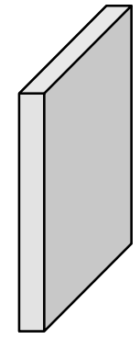
SSD adds layers on top of feature detector
300 x 300 x 3
Image
300 x 300 x 64
Block 1
150 x 150 x 128
Block 2
75 x 75 x 128
Block 3
38 x 38 x 256
Block 4
19 x 19 x 512
Block 5
VGG16 Feature map at different Conv layers
(image size - 300 x 300 x3)

Slide 101
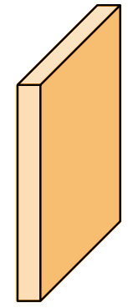
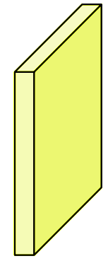
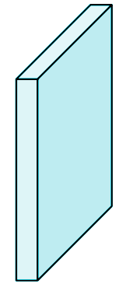
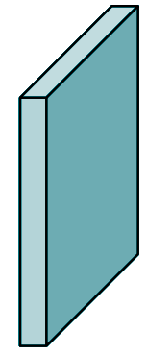
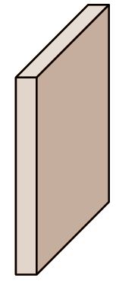
Output shape (height, width) of new layers match Grid Sizes
300 x 300 x 3
Image
300 x 300 x 64
Block 1
150 x 150 x 128
Block 2
75 x 75 x 128
Block 3
38 x 38 x 256
Block 4
19 x 19 x 512
Block 5
19 x 19 x 1024
SSD 1
10 x 10 x 512
SSD 2
5 x 5 x 256
SSD 3
3 x 3 x 256
SSD 4
1 x 1 x 256
SSD 5
VGG16 Feature map at different Conv layers
(image size - 300 x 300 x3)

Slide 102
We use additional Convolutional layer to get the desired depth (as per output needed)
Conv2D
3x3, 4*(4+C)
38 x 38 x 4 x (4+C)
Conv2D
3x3, 6*(4+C)
19 x 19 x 6 x (4+C)
Conv2D
3x3, 6*(4+C)
10 x 10 x 6 x (4+C)
Conv2D
3x3, 6*(4+C)
5 x 5 x 6 x (4+C)
Earlier VGG Layers
Conv2D
3x3, 6*(4+C)
3 x 3 x 4 x (4+C)
Conv2D
3x3, 6*(4+C)
1 x 1 x 4 x (4+C)
… the output that we needed.
38 x 38 x 256
Block 4
19 x 19 x 512
Block 5
19 x 19 x 1024
SSD 1
10 x 10 x 512
SSD 2
5 x 5 x 256
SSD 3
3 x 3 x 256
SSD 4
1 x 1 x 256
SSD 5
SSD Feature maps at different Conv layers

Slide 103
How do we calculate LOSS for Object Detectors?
Calculate loss for each ROI... but ...

Slide 104
Classification Loss
Regression Loss
Background class RoIs are under-sampled as there are too many of them.
Background class RoIs are completely ignored in loss calculation.

Slide 105
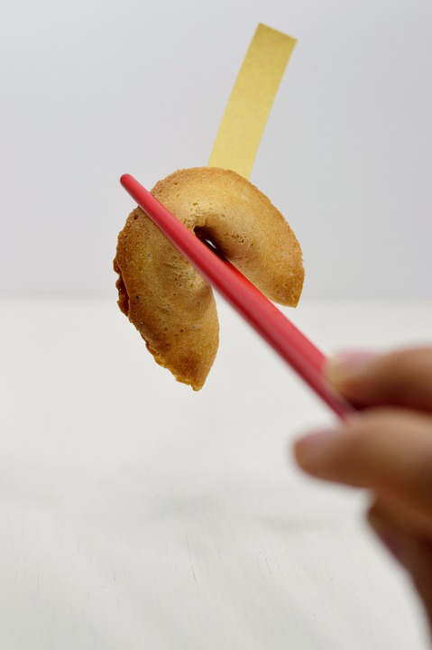
Model Prediction
For Object Detectors

Slide 106
How many objects will be predicted by our Model?
As many as number of RoIs
e.g 8,732 for SSD

Slide 107
Our images usually only have few objects (0-10) and not thousands. How do we handle that?

Slide 108
Model Predictions
...but most of the predictions will be for background class
Predicts 1000s of objects
Object Detector Model Prediction

Slide 109
Model
Predictions
Remove Background Predictions
...we will be left with much smaller number of predictions, say 100s
Predicts 1000s of objects
Object Detector Model Prediction

Slide 110
Model
Predictions
Remove Background Predictions
Lots of these predictions will be overlapping predictions
i.e Duplicate predictions
Predicts 1000s of objects
...10-100s predictions
Object Detector Model Prediction

Slide 111
Model
Predictions
Remove Background Predictions
Lots of these predictions will be overlapping predictions
i.e Duplicate predictions
Predicts 1000s of objects
...10-100s predictions
Object Detector Model Prediction

Slide 112
Dog 0.93
Dog 0.91
Dog 0.87
How do remove Duplicate predictions?
Cat 0.97
Cat 0.86
Non-Maximum Suppression (NMS)
Object Detector Model Prediction

Slide 113
Non-Maximum Suppression (NMS)
Dog 0.93
Dog 0.91
Dog 0.87
For a given class, select the prediction with highest confidence.
Calculate IOU between predicted box with highest confidence and other predicted boxes of the same class.
Remove all the lower confidence predicted boxes where IOU is above a threshold (let’s say 0.7). These are duplicate predictions.
Take the next highest confidence predicted of the same class and repeat the steps 1 to 3.
Repeat steps 1 to 4 for all the predicted classes
Cat 0.97
Cat 0.86

Slide 114
Dog 0.93
Cat 0.97
Final Predictions after NMS
Object Detector Model Prediction

Slide 115
Model
Predictions
Remove Background Predictions
Remove Duplicate Predictions
(NMS)
Final Predictions
Predicts 1000s of objects
...10-100s predictions
...0-10s predictions
Object Detector Model Prediction

Slide 116
Object Detection Summary
Understand Object Localization - detect single object in an image
Object detection involves detecting multiple objects in an image.
In Object detection, we break down the original image into multiple images and perform Object Localization on each part.
Extracted image parts are called RoI / Anchor Boxes/ Priors
R-CNN uses ‘Selective Search’ to extract RoIs
Fast-RCNN also uses Selective Search but extract RoIs from Feature Map
Faster R-CNN uses Region Proposal Network (RPN) to extract RoIs
In SSD, we (humans) provide the RoIs using multiple grids and anchor boxes (or priors)
Allow CNN to look at different RoIs to see if there is an object in the RoI and what is their bounding box.

Slide 117
Building Object Detector (SSD)
Getting data ready
Data Preparation
Collect Images
Annotate images using LabelImg tool
Class Label for each object
Boundary box for each object
Decide on RoIs
How many grids to use
Grid Sizes e.g 38x38, 19x19, 3x3 etc
Number of RoIs for each grid cell
Prepare labels (ground truths) for each RoI
Check RoI IoU with each Actual Object Box in the picture
If IoU is above a threshold (e.g 0.5)
RoI class will be same as Object class
RoI regression labels will be same Actual Object bounding box coordinates
If IoU is below the threshold
RoI class will be ‘Background’ class
RoI regression labels can be set to [0,0,0,0]
Each RoI will be assigned exactly one Object (remember Object Localization)

Slide 118
Building Object Detector (SSD)
Model Training & Prediction
Define Model
Feature Network
Pre-trained Model
Decide on which architecture to use e.g ResNet, Inception, VGG or Mobilenet
Build Detection layers
Based on Grid sizes and anchor boxes for each grid cell
Train Model
Use Image Augmentation (and boundary box augmentation)
Loss Calculation
For classification loss, undersample background class
For Regression loss, ignore anchor boxes predictions with background class
We will need to use Custom loss function
Model Prediction
Remove Background class predictions (this will be in super majority)
Remove duplicate predictions using NMS
Although, we predict on 1000s of image parts, we will have only few final predictions

Slide 119

Writing Object Detector code

Slide 120

Reduces coding effort and allows us to build production ready Object detections models
TensorFlow Object Detection API
https://github.com/tensorflow/models/tree/master/research/object_detection

Slide 121
Building Object Detector (SSD)
Getting data ready
Data Preparation
Collect Images
Annotate images using LabelImg tool
Class Label for each object
Boundary box for each object
Decide on RoI
How many grids to use
Grid Sizes e.g 38x38, 19x19, 3x3 etc
Number of RoIs for each grid cell
Prepare labels (ground truths) for each RoI
Check RoI IoU with each Actual Object Box in the picture
If IoU is above a threshold (e.g 0.5)
RoI class will be same as Object class
RoI regression labels will be same Actual Object bounding box coordinates
If IoU is below the threshold
RoI class will be ‘Background’ class
RoI regression labels can be set to [0,0,0,0]
Each RoI will be assigned exactly one Object (remember Object Localization)
Steps in blue color will be done by TensorFlow Object Detection API

Slide 122
Building Object Detector (SSD)
Model Training & Prediction
Define Model
Feature Network
Pre-trained Model
Decide on which architecture to use e.g ResNet, Inception, VGG or Mobilenet
Build Detection layers
Based on Grid sizes and anchor boxes for each grid cell
Train Model
Use Image Augmentation (and boundary box augmentation)
Loss Calculation
For classification loss, undersample background class
For Regression loss, ignore anchor boxes predictions with background class
We will need to use Custom loss function
Model Prediction
Remove Background class predictions (this will be in super majority)
Remove duplicate predictions using NMS
Although, we predict on 1000s of image parts, we will have only few final predictions

Slide 123
This API also supports Faster R-CNN
TensorFlow Object Detection API
https://github.com/tensorflow/models/tree/master/research/object_detection

Slide 124
Backup Slides

Slide 125
SSD
Normalizing Regression labels
X and Y Coordinates:
1. x & y are not xmin/ymin coordinates, rather they represent center point of actual object box.
2. The center point of anchor box is subtracted from x and y values.
3. The different in center points is normalized i.e divided by image width/height.
W and H Coordinates:
1. w & h are width and height of actual object box.
2. These values are normalized by dividing w and h by anchor box width and height.
3. SSD paper proposed to use logarithmic value of w and h (after normalization). When predicting, exponent of predicted values is calculated (reverse of logarithmic)

